Slide 1
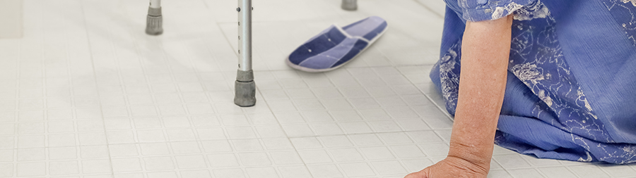
Detection, prediction and prevention of
in-hospital falls
Edwin Geleijn
VUmc innovation manager
Roser Morante
VU researcher
Notes:
Frederique, hier vraag ik je jezelf voor te stellen

Slide 3
Research question
Can we detect in-hospital fall incidents by analyzing notes from the electronic medical record with machine learning?
… and if we can detect in-hospital falls, can we also predict and prevent them

Slide 4

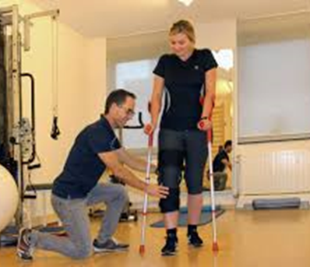
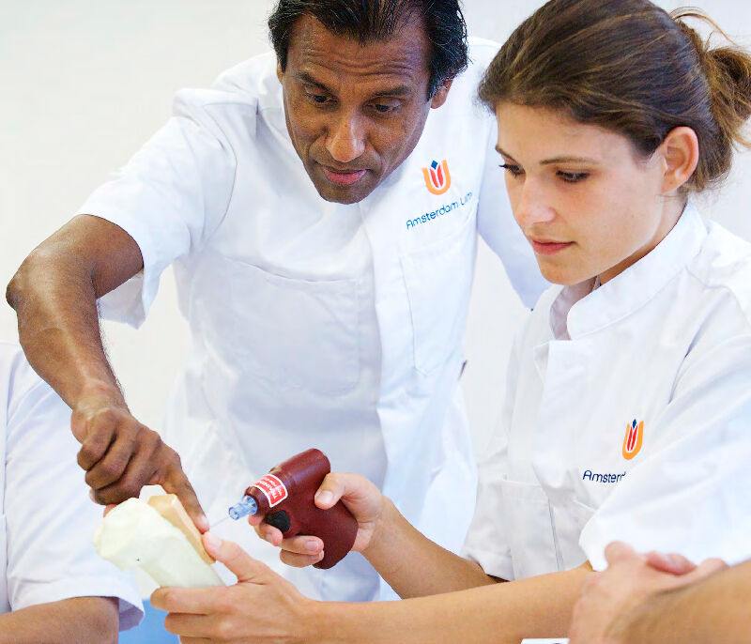
Assets
All notes from approximately 175.000 pts, which equals approximately 7.5M notes
A dedicated server, that meets all privacy demands
Clearance from the privacy officers / medical director to use the data for the purpose of the research question

Slide 5


Already done
Created an annotated database containing approximately 500 in-hospital falls
Trained a machine learning algorithm (X-boost) to detect in-hospital falls
  Recall ~90%
  Precision ~20%

Slide 6

Next steps
Looking for
Improving precission
From detection to prediction of in-hospital falls
World improvers
Team players
Data crunchers

Slide 7
e.geleijn@amsterdamumc.nl
r.morantevallejo@vu.nl

