Slide 1
What we do, and what you could do with us
Zoltán Szlávik, AI Research Director
Selene Baez Santamaria, Researcher
13/12/2019

Slide 2

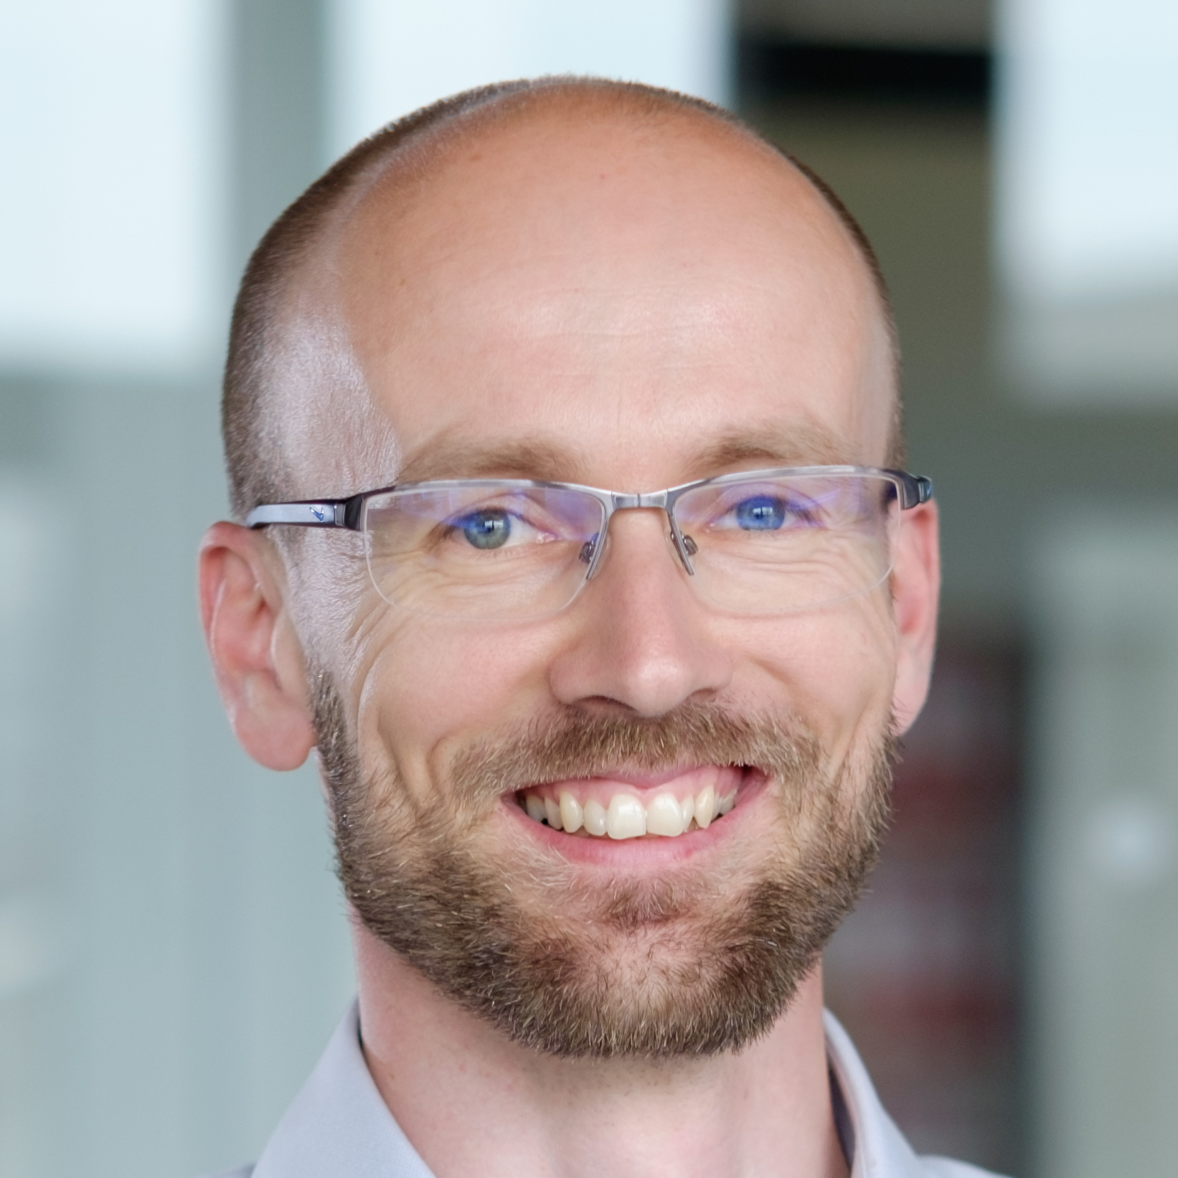



1998 – 2003, Computer Science
2004 – 2008, Information Retrieval
2009 – 2012, Computational Intelligence
2013 – 2015, Advanced Analytics
2015 – (May) 2019, Center for Advanced Studies
(June) 2019 – present, myT AI Research
2013 – present, VU Computer Science
2015 – present, TUD Computer Science
2018 – present, U. of Exeter
@zolley

Slide 3
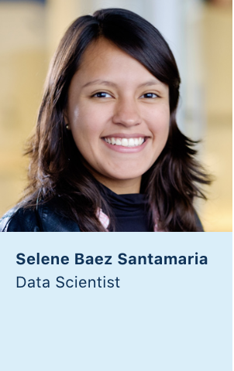
2011 – 2014, BSc Cognitive Systems
2013 – 2015, Tech Rover
2015 – 2017, MSc Artificial Intelligence
2015 - 2016 , Center for Advanced Studies
(October) 2017 – present, AI Researcher
Notes:
Coding since I was 15, but never considered myself a compuer scientist
Always been interdisciplinary
Cognitive systems (5/34): Computer science (11), psychology (4), philosophy (4), linguistics (1), {“science” (4), math (5)}
Some contact with business, but enough to learn that is not my preferred area of specialization

Slide 4
Unmet medical need

Slide 5
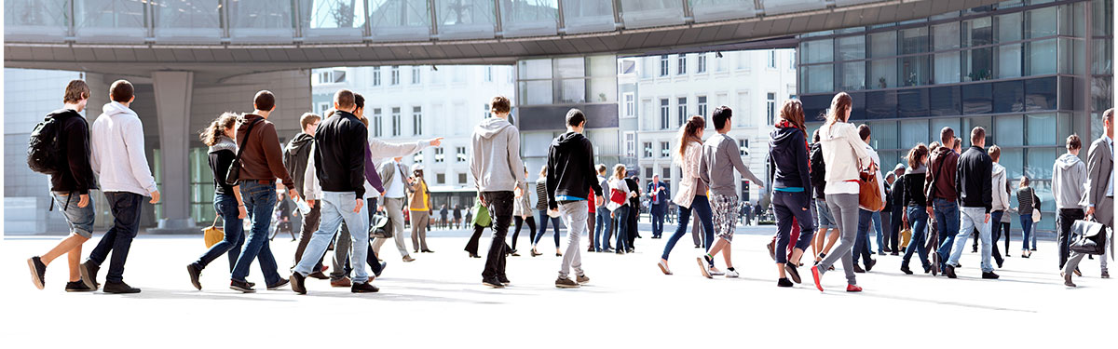
There are over 10.000 known diseases
and only 500 treatments.
Notes:
THIS IS FROM 21ST CURES ACT REPORT

Slide 6
myTomorrows’ mission:
To facilitate access to medicines under development
to patients with unmet medical needs.
Notes:
After this slide and before the next one we need a slide with bullet points:
Provide comprehensive and accurate information
Negotiate with originator pharma companies
Simplify the regulatory administrative burden
Deliver the drugs
Negotiate reimbursement / payment
Collect safety and outcome data
Provide useful data back to all parties – patients, physicians, companies, regulators, payors, public
- Without interfering with the clinical development and clinical trial program.

Slide 7
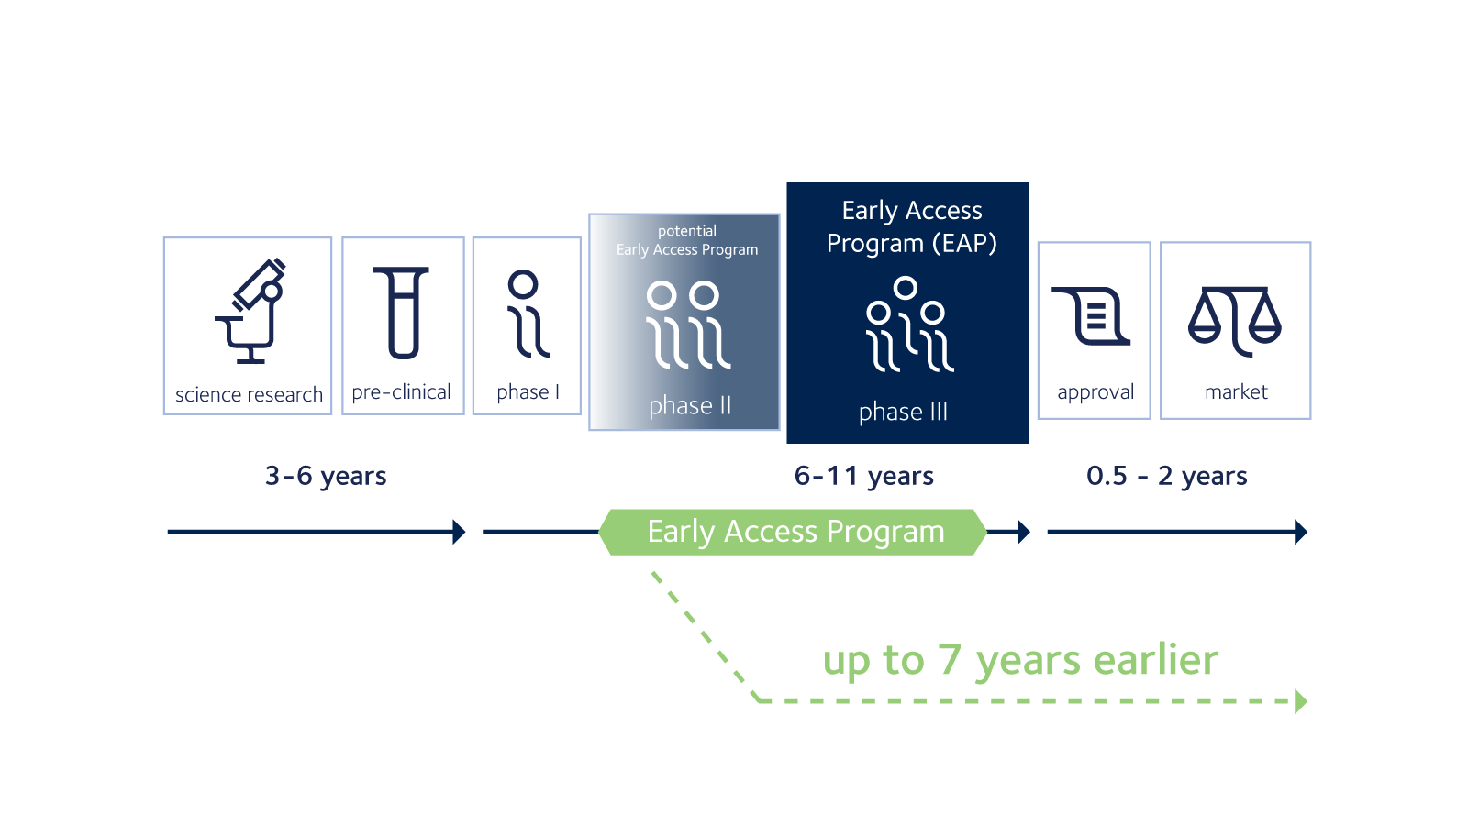
When is Early Access possible?

Slide 8







Addressing unmet medical needs by improving access to treatments currently in development
Outreach
Engage
Inform
Assist
Treat
Free consultation with medical team,
1:1 intake if eligible
Tailored treatment report
based on the accumulated patient data and Knowledge Base search outcome
Assist the patient with
actionable next steps towards a CT, EAP or RegArb treatment
Provide the treating physician with the medicines
Medical Data
Collection & Structuring
Treatment Data
Collection & Processing
Heavy AI/Data Science involvement
myT knowledge graph
https://mytomorrows.com/
Anthony Fokkerweg 61,
1059 CP Amsterdam NL
Nearest metro: Henk Sneevlietweg
For internships and collaboration contact us at research@mytomorrows.com

