Slide 1
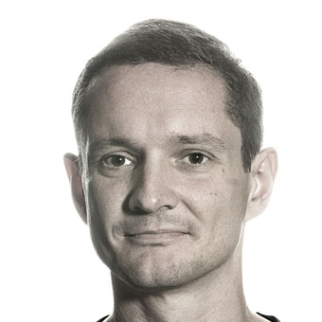
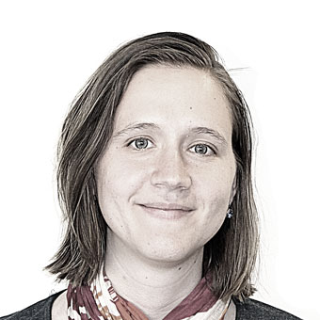
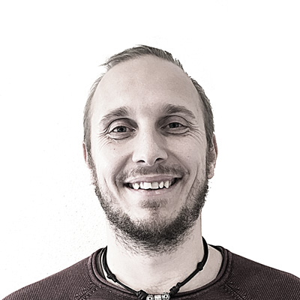
NLP at the eScience Center
Dafne van Kuppevelt
Amsterdam, 23 April 2019

Slide 2
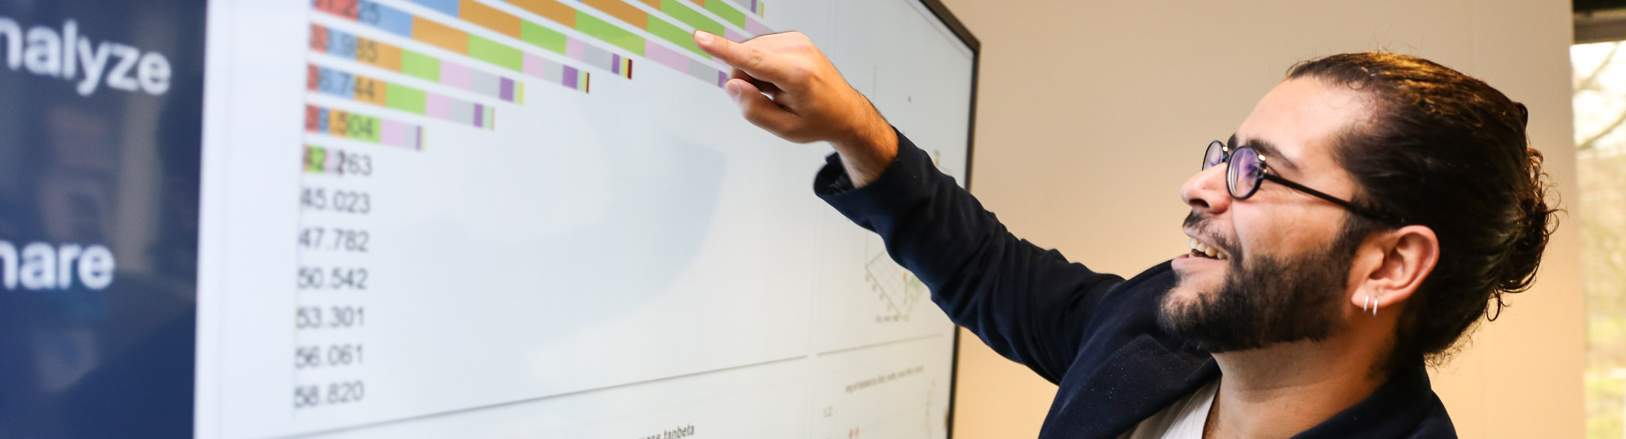
Photography: Elodie Burrillon
Our mission
Enabling digitally enhanced research through efficient utilization of data, software and e-infrastructure

Slide 3
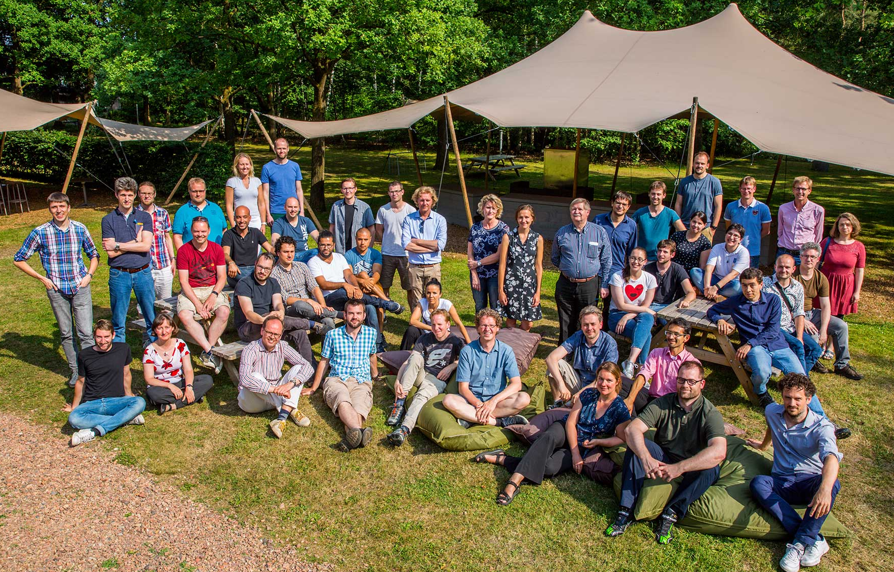
Our team (mid 2018)
Notes:
Our main asset: people people people with their expertise and collaborative nature.

Slide 4
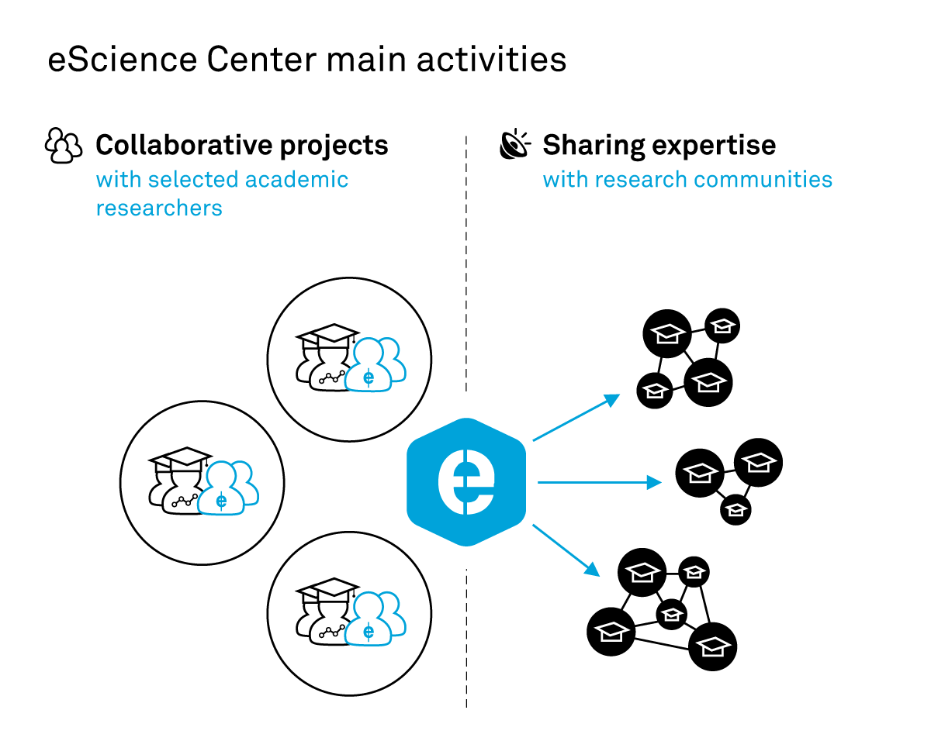
Our strategy
Notes:
Our new strategy: maintain collaborative proposals with selected excellent researchers (with peer review) and strengthen sharing expertise to all of research. Scaling can only happen if we do that to research communities either at campus level or in research domains that are organized already.

Slide 5
Example Projects with NLP

Slide 6
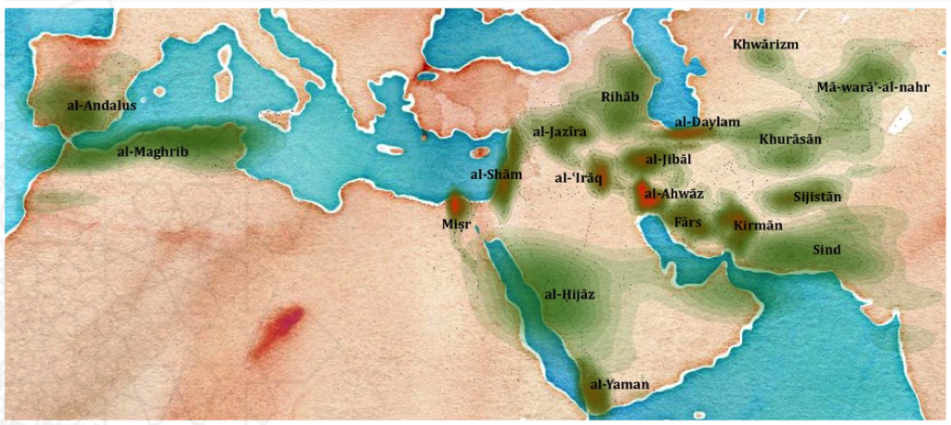

Bridging the Gap: Arabic digital humanities
Notes:
Long-duree analysis of Arabic texts from 12 centuries
How does thought about free reasoning differ per region or school, and evolve over time?
Which of the 5 senses are important for Arabic scholars over time?

Slide 7
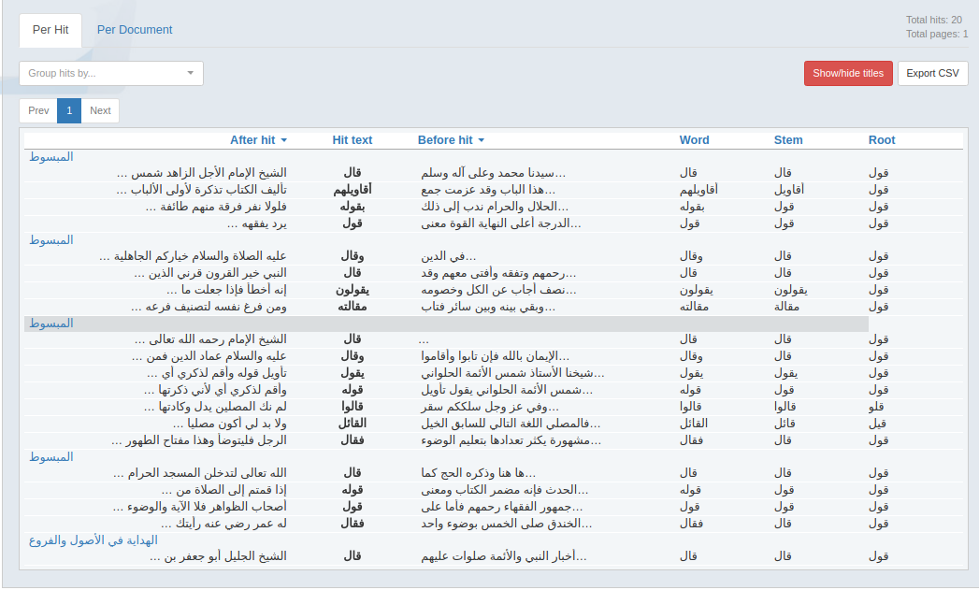
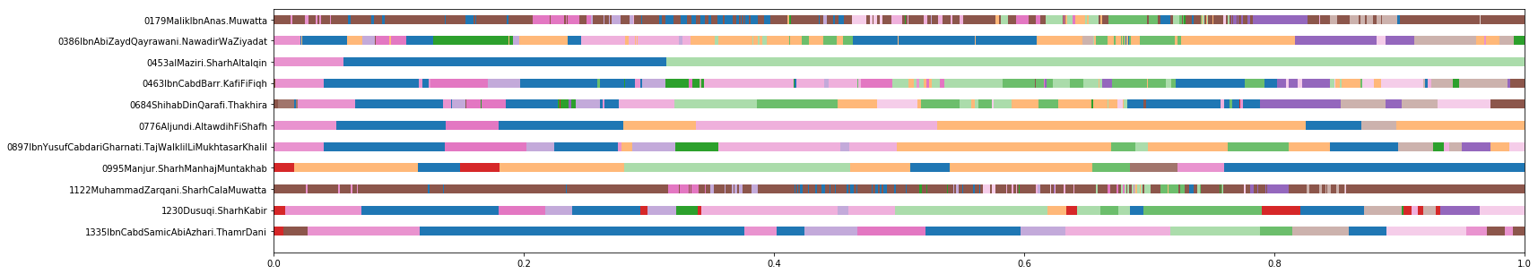
eScience solution
Adapt available technology to Arabic corpus
Explore text mining for Islamic studies
Notes:
Left-to-right
Morphologically complex language
(word = root + prefix, suffix, infix)
Arabic not integrated in standard text mining tools
Topic modeling
Query set expansion with word embeddings

Slide 8
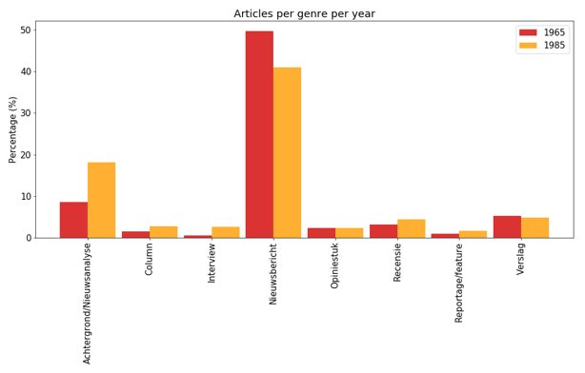
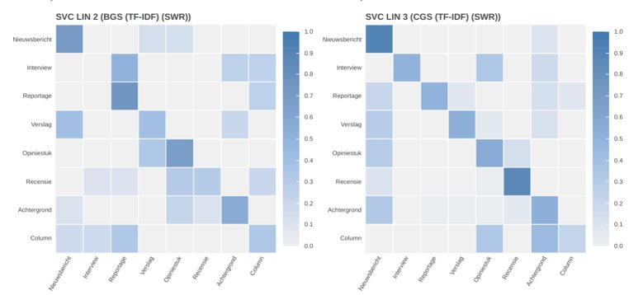
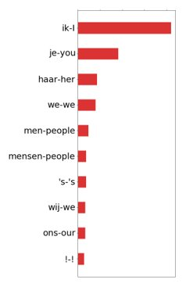
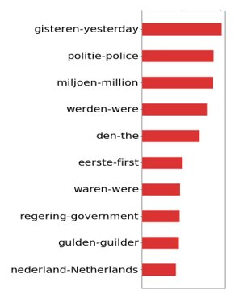
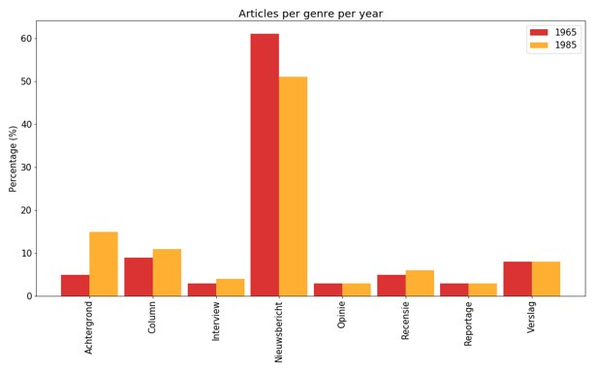
NEWSGAC – labeling news genres

Slide 9

Inside the Filter Bubble
What is the diversity of people's news consumption?
NLP challenge: Detect perspectives on controversial issues in news articles
    Topic classification
    Vocabulary
    Semantic role labeling

Slide 10
Careers
eScience Research Engineer positions:
    https://www.esciencecenter.nl/about/careers
Internships: Possible if we find a good fit
    Come talk to us
    Send email with CV

Slide 11
Let’s stay in touch
+31 (0)20 460 4770
info@esciencecenter.nl
www.esciencecenter.nl
blog.esciencecenter.nl
Dafne: d.vankuppevelt@esciencecenter.nl
Willem: w.vanhage@esciencecenter.nl
Meiert: m.grootes@esciencecenter.nl
eScienceCenter
eScienceCenter
linkd.in/1j2uS8S

